Slide 1
ECE 250 Algorithms and Data Structures
All-pairs shortest path
Douglas Wilhelm Harder, M.Math. LEL
Department of Electrical and Computer Engineering
University of Waterloo
Waterloo, Ontario, Canada
ece.uwaterloo.ca
dwharder@alumni.uwaterloo.ca
© 2006-2013 by Douglas Wilhelm Harder. Some rights reserved.

Slide 2
Outline
This topic will:
Review Dijkstra’s algorithm for finding a shortest path
Consider what happens if we want to find all shortest paths
We will look at the Floyd-Warshall algorithm for:
Finding these shortest distances
Finding the paths corresponding to these distances
We conclude by finding the transitive closure

Slide 3
Background
5.1
Dijkstra’s algorithm finds the shortest path between two nodes
Run time:
If we wanted to find the shortest path between all pairs of nodes, we could apply Dijkstra’s algorithm to each vertex:
Run time:
In the worst case, if , the run time is

Slide 4
Background
5.1
Any algorithm that finds the shortest path between all pairs must consider, each pair of vertices; therefore, a lower bound on the execution would be
Now, Dijkstra’s algorithm has the following run times:
Best case:
If , running Dijkstra for each vertex is
Worst case:
If , running Dijkstra for each vertex is

Slide 5
Problem
5.1.1
Question: for the worst case, can we find a algorithm?
We will look at the Floyd-Warshall algorithm

Slide 6
Strategy
5.1.2
First, let’s consider only edges that connect vertices directly:
Here, w_{i,j} is the weight of the edge connecting vertices i and j
Note, this can be a directed graph; i.e., it may be that
In C++, we would define a two-dimensional array
double d[num_vertices][num_vertices];

Slide 7
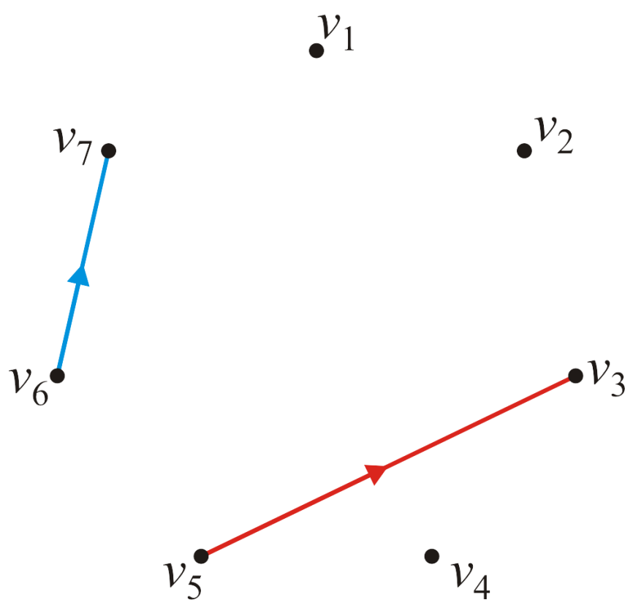
Strategy
5.1.2
Consider this graph of seven vertices
The edges defining the values and are highlighted

Slide 8
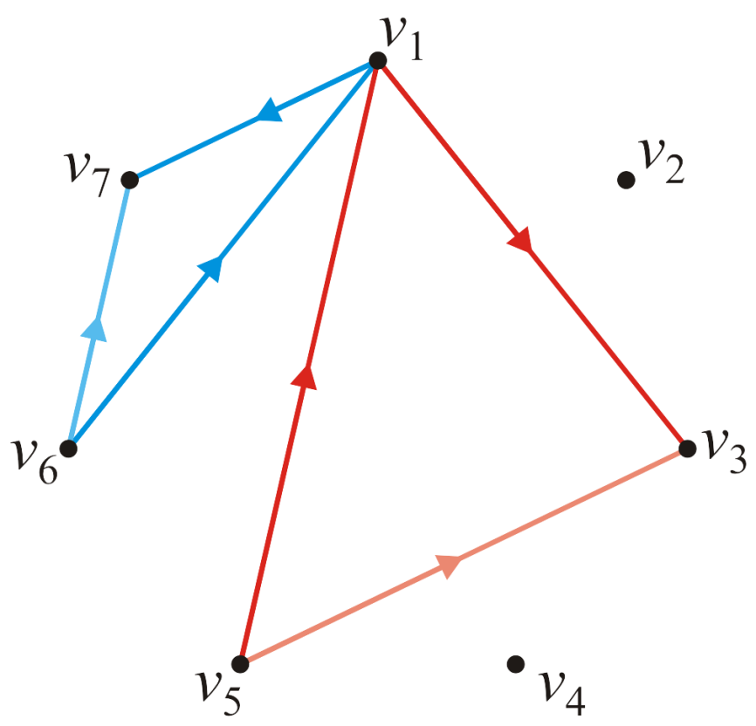
Strategy
5.1.2
Suppose now, we want to see whether or not the path going through vertex v₁ is shorter than a direct edge?
Is ?
Is ?

Slide 9
Strategy
5.1.2
Thus, for each pair of edges, we will define by calculating:

Slide 10
Strategy
5.1.2
Note that and ; thus, we need just run the algorithm for each pair of vertices:
for ( int i = 0; i < num_vertices; ++i ) {
for ( int j = 0; j < num_vertices; ++j ) {
d[i][j] = std::min( d[i][j], d[i][0] + d[0][j] );
}
}

Slide 11
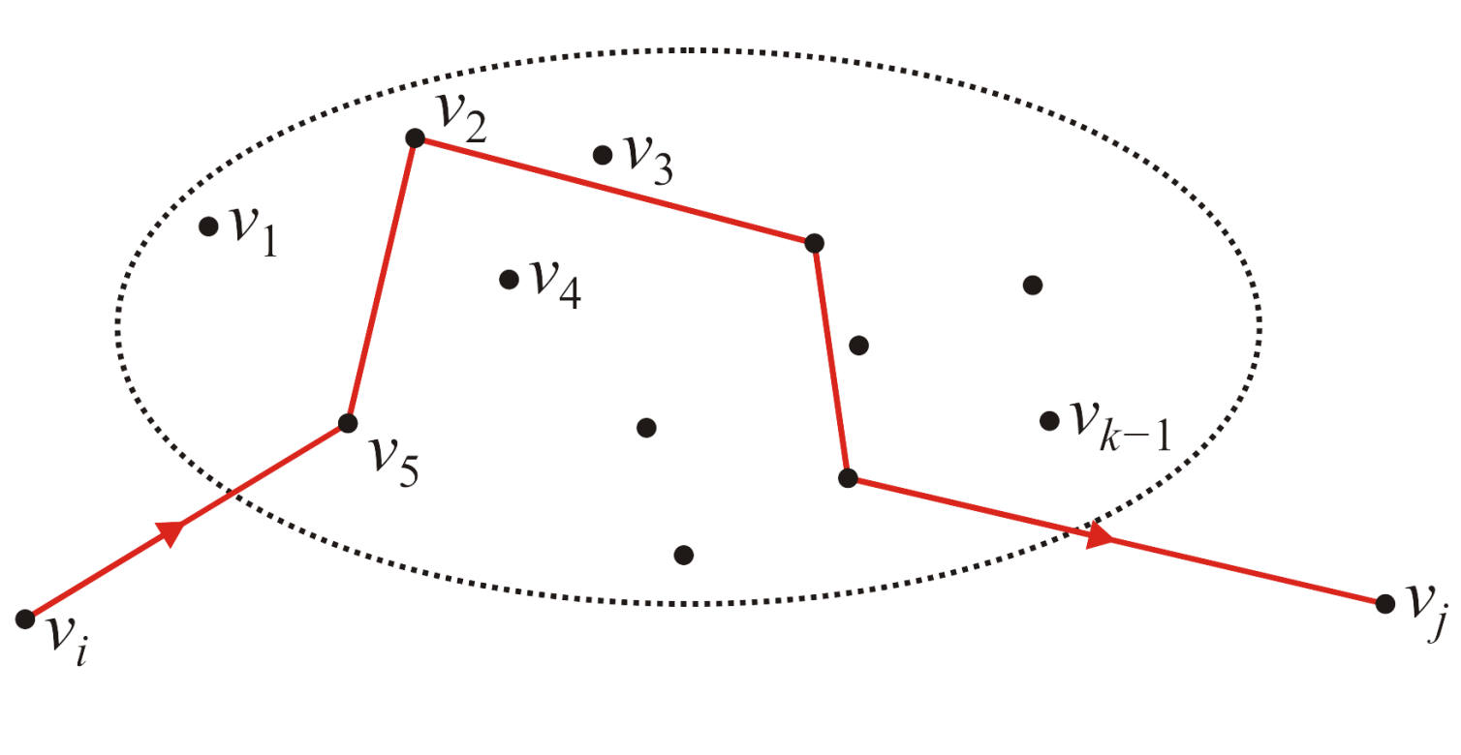
The General Step
5.1.2
Define as the shortest distance, but only allowing intermediate visits to vertices v₁, v₂, …, v_{k–1}
Suppose we have an algorithm that has found these values for all pairs

Slide 12
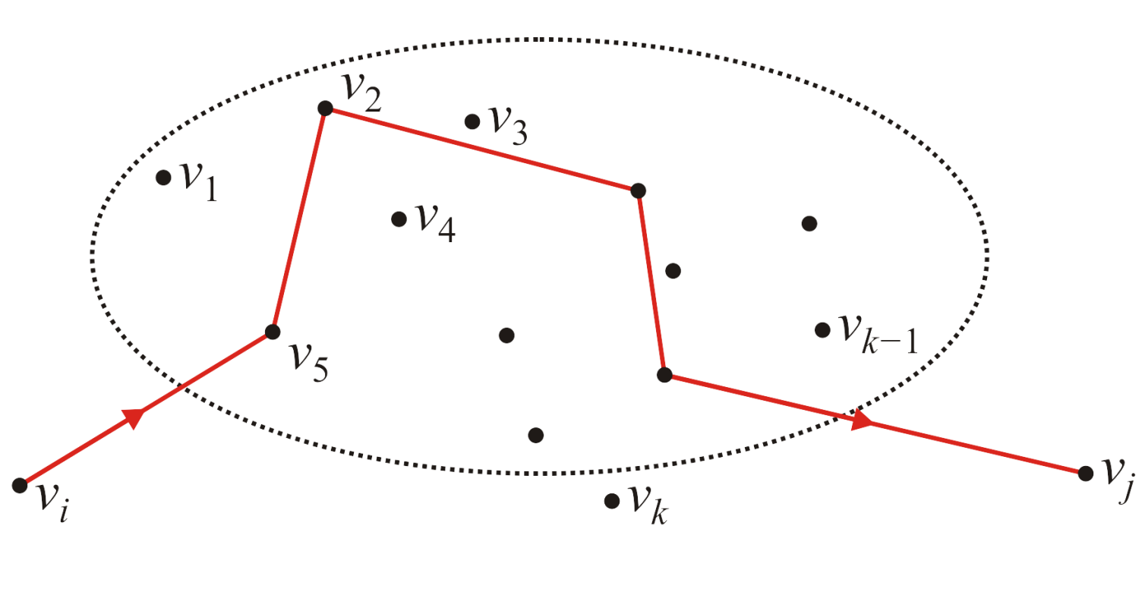
The General Step
5.1.2
How could we find ; that is, the shortest path allowing intermediate visits to vertices v₁, v₂, …, v_{k–1} , v_{k}?

Slide 13
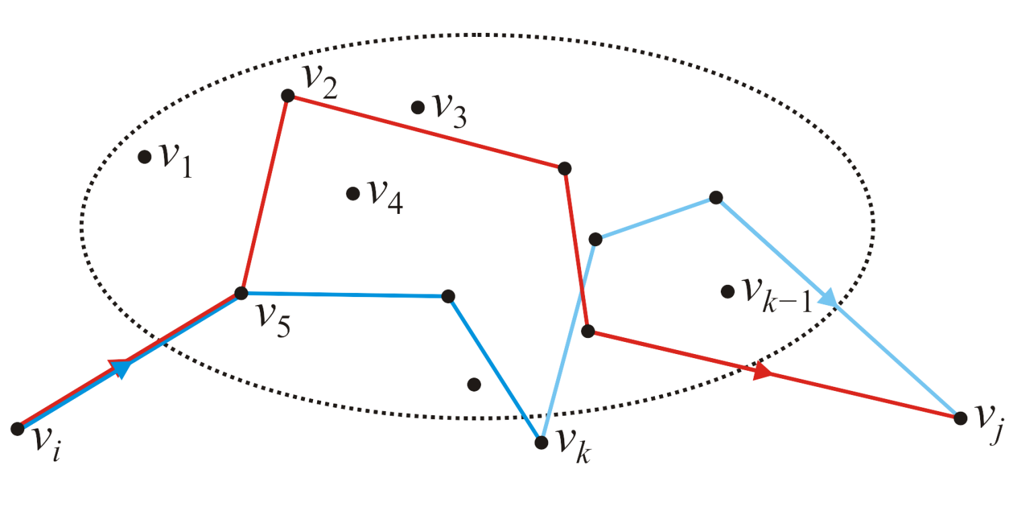
The General Step
5.1.2
With v₁, v₂, …, v_{k–1} as intermediates, have assumed we have found the shortest paths from v_{i} to v_{j}, v_{i} to v_{k} and v_{k} to v_{j}
The only possible shorter path including v_{k} would be the path from v_{i} to v_{k} continuing from there to v_{j}
Thus, we calculate

Slide 14
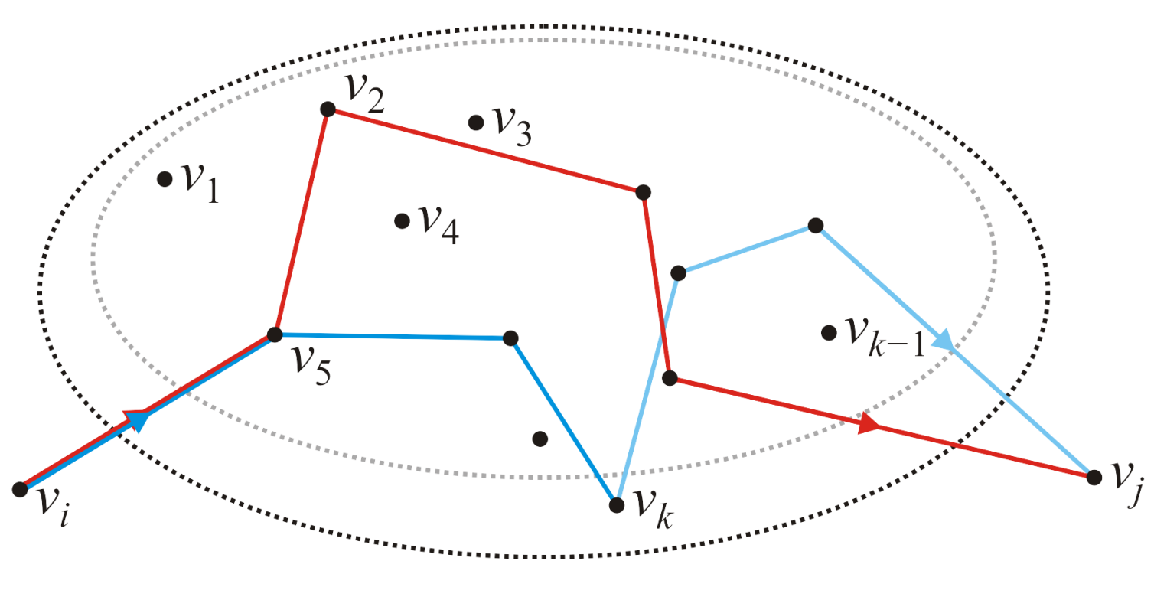
The General Step
5.1.2
Finding this for all pairs of vertices gives us all shortest paths from v_{i} to v_{j} possibly going through vertices v₁, v₂, …, v_{k}
Again, note that and do not change under this step
To simplify, the notation, we can remove the superscripts

Slide 15
The General Step
5.1.2
Thus, the calculation is straight forward:
for ( int i = 0; i < num_vertices; ++i ) {
for ( int j = 0; j < num_vertices; ++j ) {
d[i][j] = std::min( d[i][j], d[i][k] + d[k][j] );
}
}

Slide 16
The Floyd-Warshall Algorithm
5.1.2
Thus, we have found the Floyd-Warshall algorithm:
Run time?
double d[num_vertices][num_vertices];
// Initialize the matrix d: Theta(|V|^2)
// ...
// Run Floyd-Warshall
for ( int k = 0; k < num_vertices; ++k ) {
for ( int i = 0; i < num_vertices; ++i ) {
for ( int j = 0; j < num_vertices; ++j ) {
d[i][j] = std::min( d[i][j], d[i][k] + d[k][j] );
}
}
}

Slide 17
The Floyd-Warshall Algorithm
5.1.2
Question: we’ve already argued that at step k, d_{i,k} and d_{k,j} remain unchanged, would you want to avoid the calculation if i = k or j = k?
Would you perform checks to avoid a operation?
// Run Floyd-Warshall
for ( int k = 0; k < num_vertices; ++k ) {
for ( int i = 0; i < num_vertices; ++i ) {
for ( int j = 0; j < num_vertices; ++j ) {
if ( i != k && j != k ) {
d[i][j] = std::min( d[i][j], d[i][k] + d[k][j] );
}
}
}
}

Slide 18
The Floyd-Warshall Algorithm
5.1.2
In such a case, if you must absolutely minimize the iterations:
// Run Floyd-Warshall
for ( int k = 0; k < num_vertices; ++k ) {
for ( int i = 0; i < k; ++i ) {
for ( int j = 0; j < k; ++j ) {
d[i][j] = std::min( d[i][j], d[i][k] + d[k][j] );
}
for ( int j = k + 1; j < num_vertices; ++j ) {
d[i][j] = std::min( d[i][j], d[i][k] + d[k][j] );
}
}
for ( int i = k + 1; i < num_vertices; ++i ) {
for ( int j = 0; j < k; ++j ) {
d[i][j] = std::min( d[i][j], d[i][k] + d[k][j] );
}
for ( int j = k + 1; j < num_vertices; ++j ) {
d[i][j] = std::min( d[i][j], d[i][k] + d[k][j] );
}
}
}
If you do this, document it well!

Slide 19
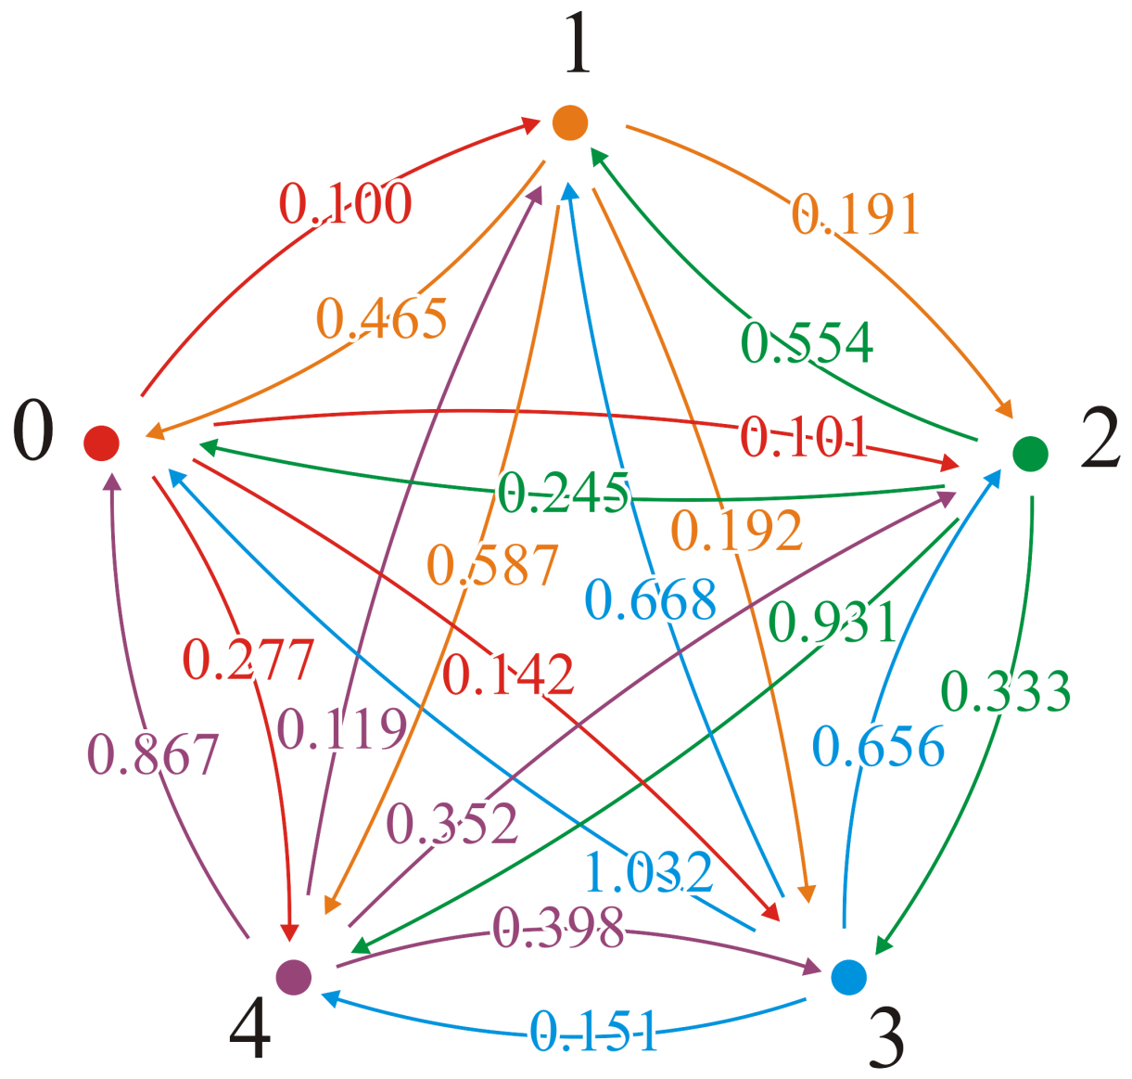
Example
Consider this graph

Slide 20
Example
The adjacency matrix is
This would define our matrix D = (d_{ij})

Slide 21

Example
With the first pass, k = 1, we attempt passing through vertex v₁
We would start: (2, 3) → (2, 1, 3)
0.191 ≯ 0.465 + 0.101

Slide 22
Example
With the first pass, k = 1, we attempt passing through vertex v₁
We would start: (2, 4) → (2, 1, 4)
0.192 ≯ 0.465 + 0.142

Slide 23
Example
With the first pass, k = 1, we attempt passing through vertex v₁
We would start: (2, 5) → (2, 1, 5)
0.587 ≯ 0.465 + 0.277

Slide 24
Example
With the first pass, k = 1, we attempt passing through vertex v₁
Here is a shorter path: (3, 2) → (3, 1, 2)
0.554 > 0.245 + 0.100 = 0.345

Slide 25
Example
With the first pass, k = 1, we attempt passing through vertex v₁
We update the table (3, 2) → (3, 1, 2)
0.554 > 0.245 + 0.100 = 0.345

Slide 26
Example
With the first pass, k = 1, we attempt passing through vertex v₁
And a second shorter path: (3, 5) → (3, 1, 5)
0.931 > 0.245 + 0.277 = 0.522

Slide 27
Example
With the first pass, k = 1, we attempt passing through vertex v₁
We update the table

Slide 28
Example
With the first pass, k = 1, we attempt passing through vertex v₁
Continuing: (4, 2) → (4, 1, 2)
0.668 ≯ 1.032 + 0.100
In fact, no other shorter paths through vertex v₁ exist

Slide 29
Example
With the next pass, k = 2, we attempt passing through vertex v₂
There are three shorter paths: (5, 1) → (5, 2, 1)
0.867 > 0.119 + 0.465 = 0.584 (5, 3) → (5, 2, 3)
0.352 > 0.119 + 0.191 = 0.310
(5, 4) → (5, 2, 4)
0.398 > 0.119 + 0.192 = 0.311

Slide 30
Example
With the next pass, k = 2, we attempt passing through vertex v₂
We update the table

Slide 31
Example
With the next pass, k = 3, we attempt passing through vertex v₃
There are three shorter paths: (2, 1) → (2, 3, 1)
0.465 > 0.191 + 0.245 = 0.436 (4, 1) → (4, 3, 1)
1.032 > 0.656 + 0.245 = 0.901
(5, 1) → (5, 3, 1)
0.584 > 0.310 + 0.245 = 0.555

Slide 32
Example
With the next pass, k = 3, we attempt passing through vertex v₃
We update the table

Slide 33
Example
With the next pass, k = 4, we attempt passing through vertex v₄
There are two shorter paths: (2, 5) → (2, 4, 5)
0.587 > 0.192 + 0.151 (3, 5) → (3, 4, 5)
0.522 > 0.333 + 0.151

Slide 34
Example
With the next pass, k = 4, we attempt passing through vertex v₄
We update the table

Slide 35
Example
With the last pass, k = 5, we attempt passing through vertex v₅
There are three shorter paths: (4, 1) → (4, 5, 1)
0.901 > 0.151 + 0.555 = 0.706 (4, 2) → (4, 5, 2)
0.668 > 0.151 + 0.119 = 0.270
(4, 3) → (4, 5, 3)
0.656 > 0.151 + 0.310 = 0.461

Slide 36
Example
With the last pass, k = 5, we attempt passing through vertex v₅
We update the table

Slide 37
Example
Thus, we have a table of all shortest paths:

Slide 38
What Is the Shortest Path?
This algorithm finds the shortest distances, but what are the paths corresponding to those shortest distances?
Recall that with Dijkstra’s algorithm, we could find the shortest paths by recording the previous node
You would start at the end and work your way back…

Slide 39
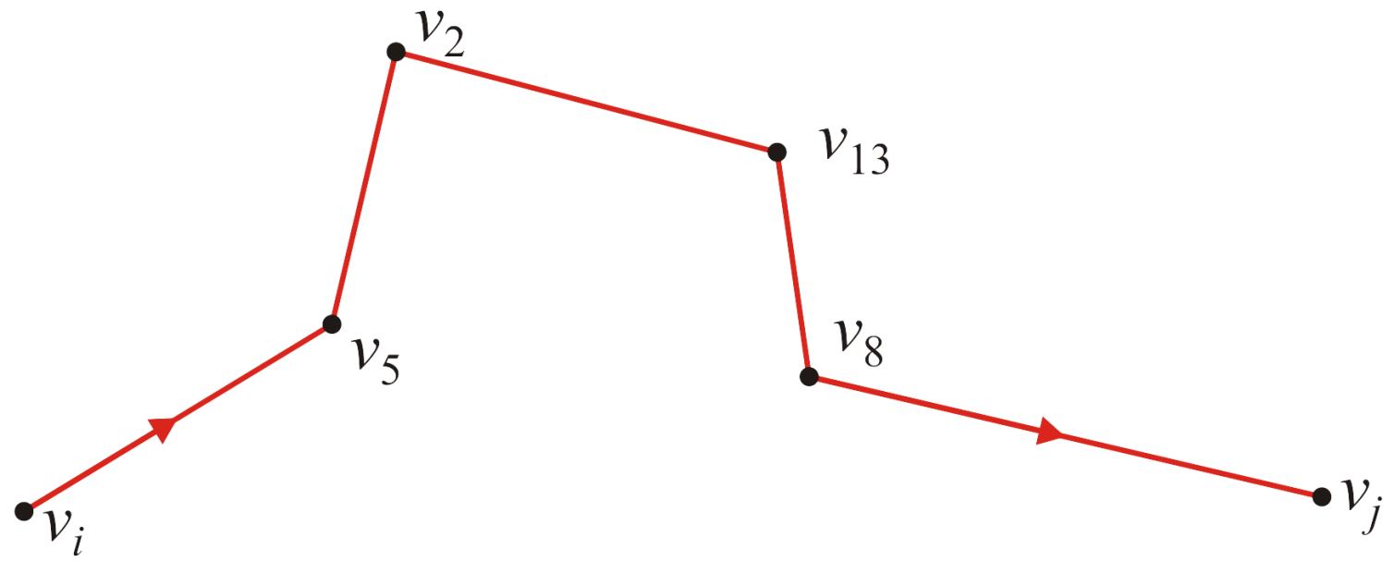
What Is the Shortest Path?
Suppose the shortest path from v_{i} to v_{j} is as follows:

Slide 40
What Is the Shortest Path?
Is this path not the (v_{i}, v₅) followed by the shortest path from v₅ to v_{j}?
If there was a shorter path from v_{i} to v_{j} through v₅ that didn’t follow v₂, v₁₃, etc., then we would also find a shorter path from v₅ to v_{j}

Slide 41
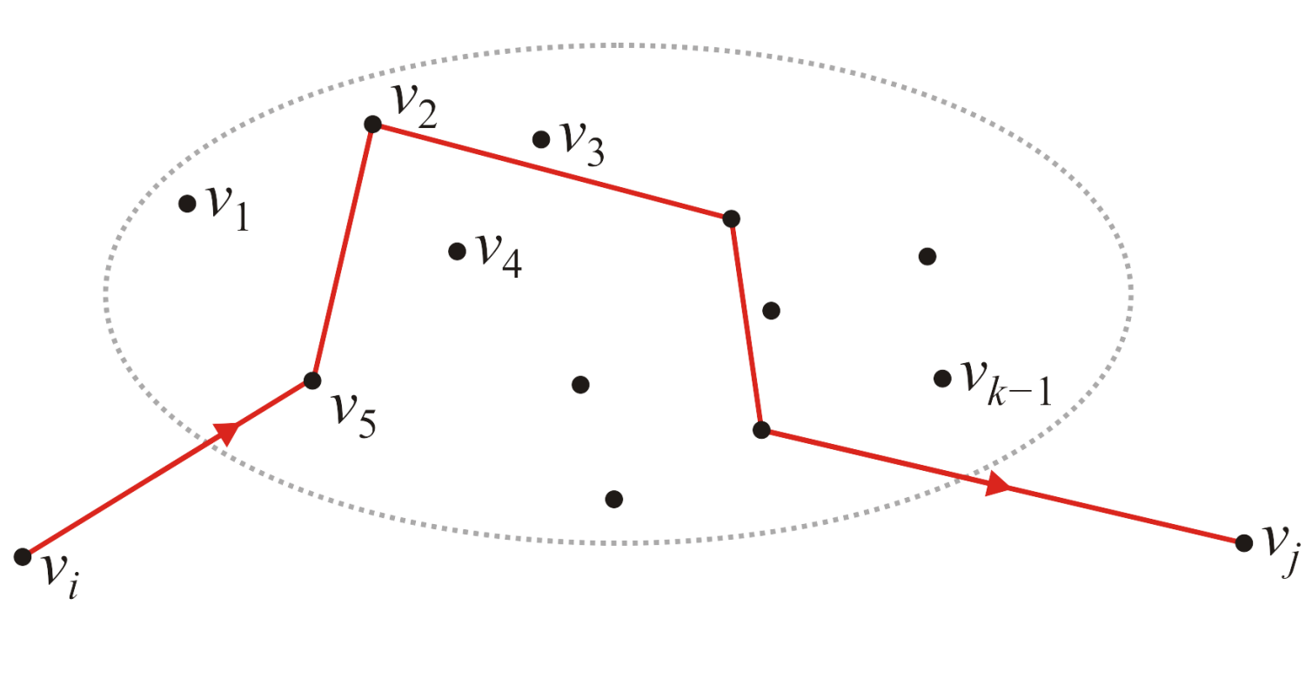
What Is the Shortest Path?
Now, suppose we have the shortest path from v_{i} to v_{j} which passes through the vertices v₁, v₂, …, v_{k–1}
In this example, the next vertex in the path is v₅

Slide 42
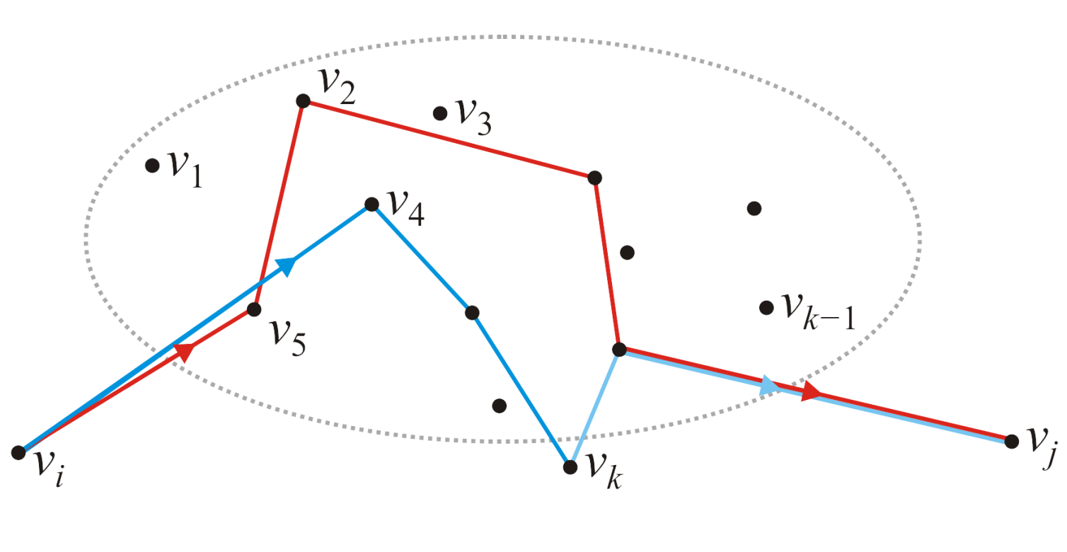
What Is the Shortest Path?
What if we find a shorter path passing through v_{k}?
In this example, all we’d have to do is now remember that the new path has v₄ as the second node—the rest of the path would be recursively stored as the shortest path from v₄ to v_{j}

Slide 43
What Is the Shortest Path?
In this case, let us store the shortest path moving forward:
Now, if we find a shorter path, update the value
This matrix will store the next vertex in the list in the shortest path starting at vertex v_{i}

Slide 44
What Is the Shortest Path?
Thus, if we ever find a shorter path, update it the next node:
unsigned int p[num_vertices][num_vertices];
// Initialize the matrix p: Theta(|V|^2)
// ...
// Run Floyd-Warshall
for ( int k = 0; k < num_vertices; ++k ) {
for ( int i = 0; i < num_vertices; ++i ) {
for ( int j = 0; j < num_vertices; ++j ) {
if ( d[i][j] > d[i][k] + d[k][j] ) {
p[i][j] = p[i][k];
d[i][j] = d[i][k] + d[k][j];
}
}
}
}

Slide 45
Example
In our original example, initially, the next node is exactly that:
This would define our matrix P = (p_{ij})

Slide 46
Example
With the first pass, k = 1, we attempt passing through vertex v₁
There are two shorter paths: (3, 2) → (3, 1, 2)
0.554 > 0.245 + 0.100 (3, 5) → (3, 1, 5)
0.931 > 0.245 + 0.277

Slide 47
Example
With the first pass, k = 1, we attempt passing through vertex v₁
We update each of these

Slide 48
Example
After all the steps, we end up with the matrix P = (p_{i,j}):

Slide 49
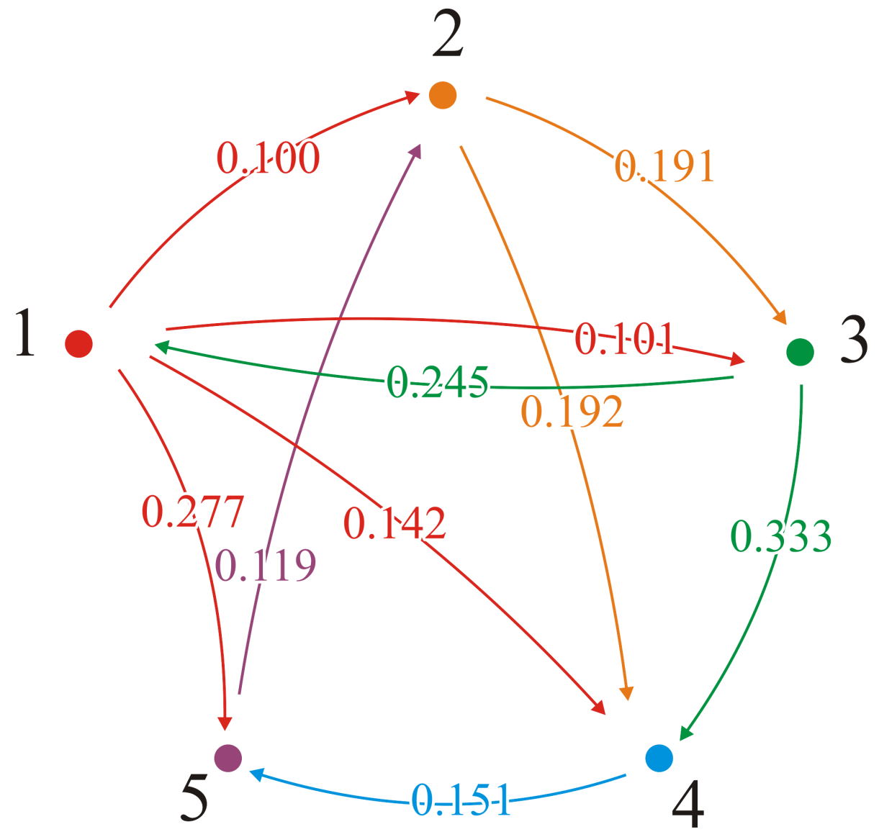
Example
These are all the adjacent edges that are still the shortest distance
For each of these, p_{i,j} = j
In all cases, the shortest distance from vertex 0 is the direct edge

Slide 50
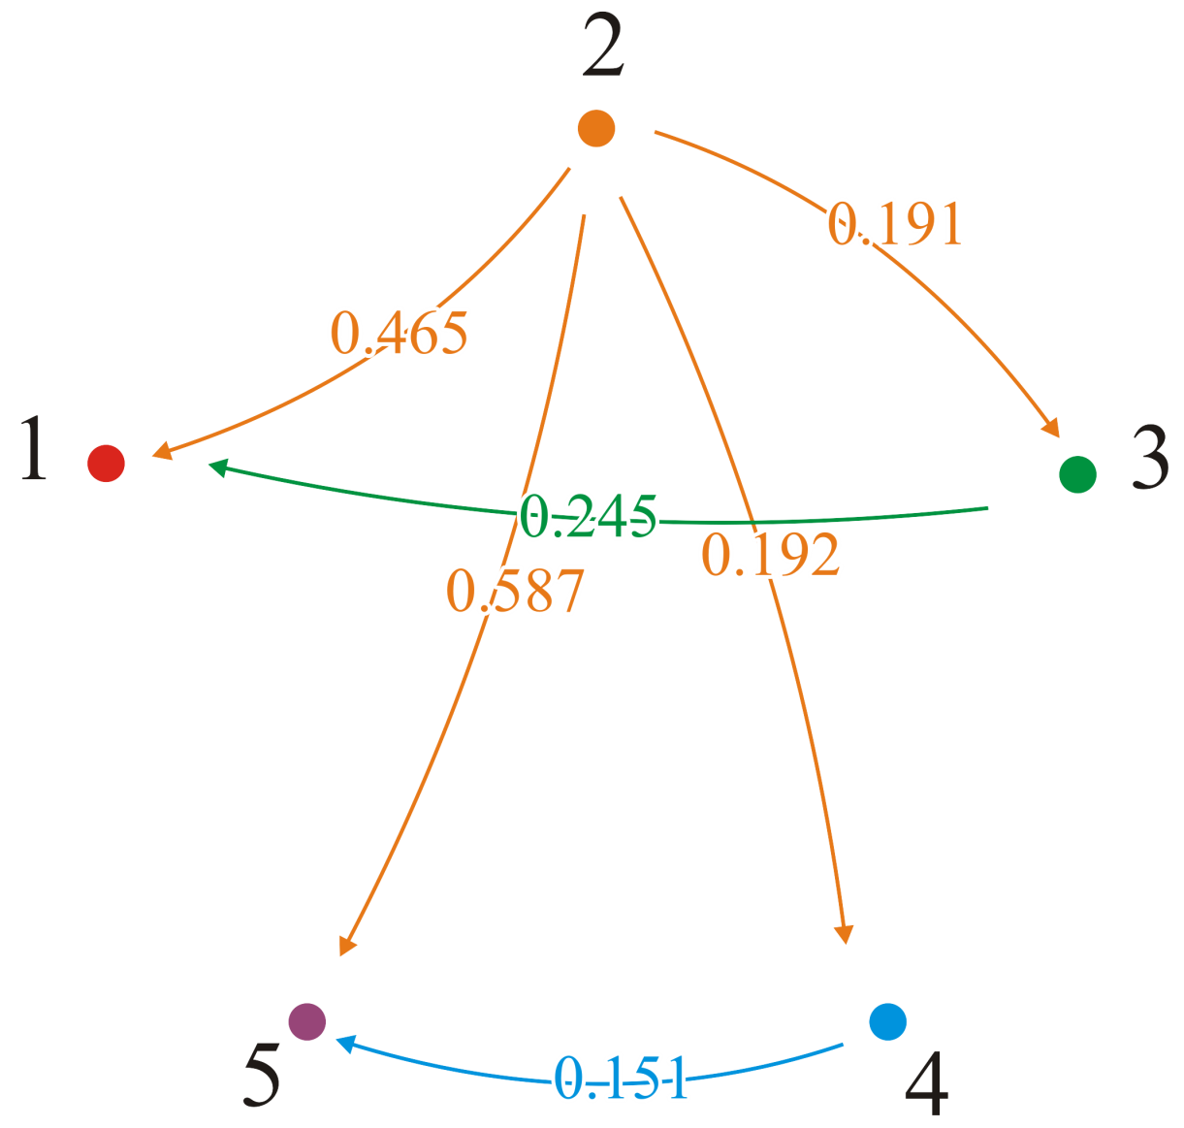
Example
From vertex v₂, p_{2,3} = 3 and p_{2,4} = 4; we go directly to vertices v₃ and v₄
But p_{2,1} = 3 and p_{3,1} = 1; the shortest path to v₁ is (2, 3, 1)
Also, p_{2,5} = 4 and p_{4,5} = 5; the shortest path to v₅ is (2, 4, 5)

Slide 51
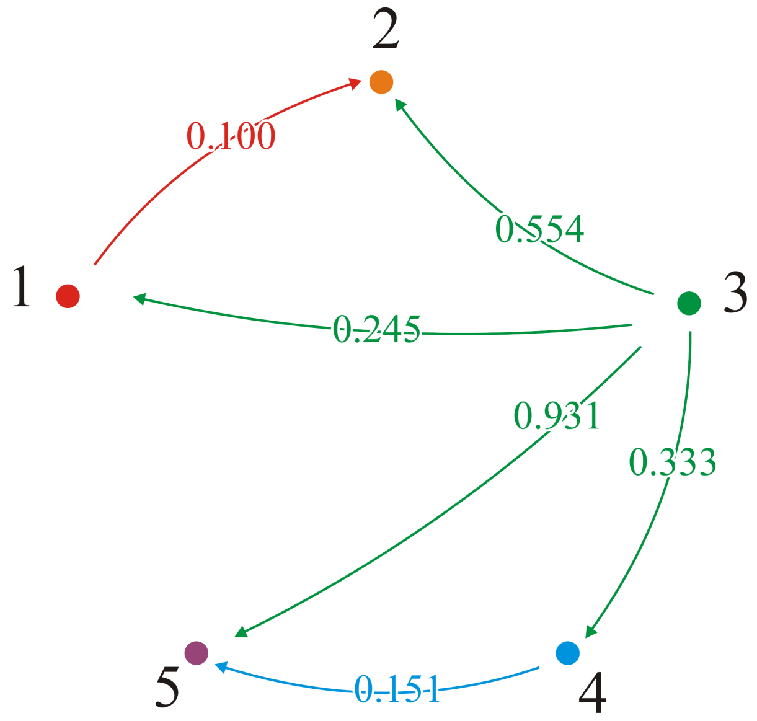
Example
From vertex v₃, p_{3,1} = 1 and p_{3,4} = 4; we go directly to vertices v₁ and v₄
But p_{3,2} = 1 and p_{1,2} = 2; the shortest path to v₂ is (3, 1, 2)
Also, p_{3,5} = 4 and p_{4,5} = 5; the shortest path to v₅ is (3, 4, 5)

Slide 52
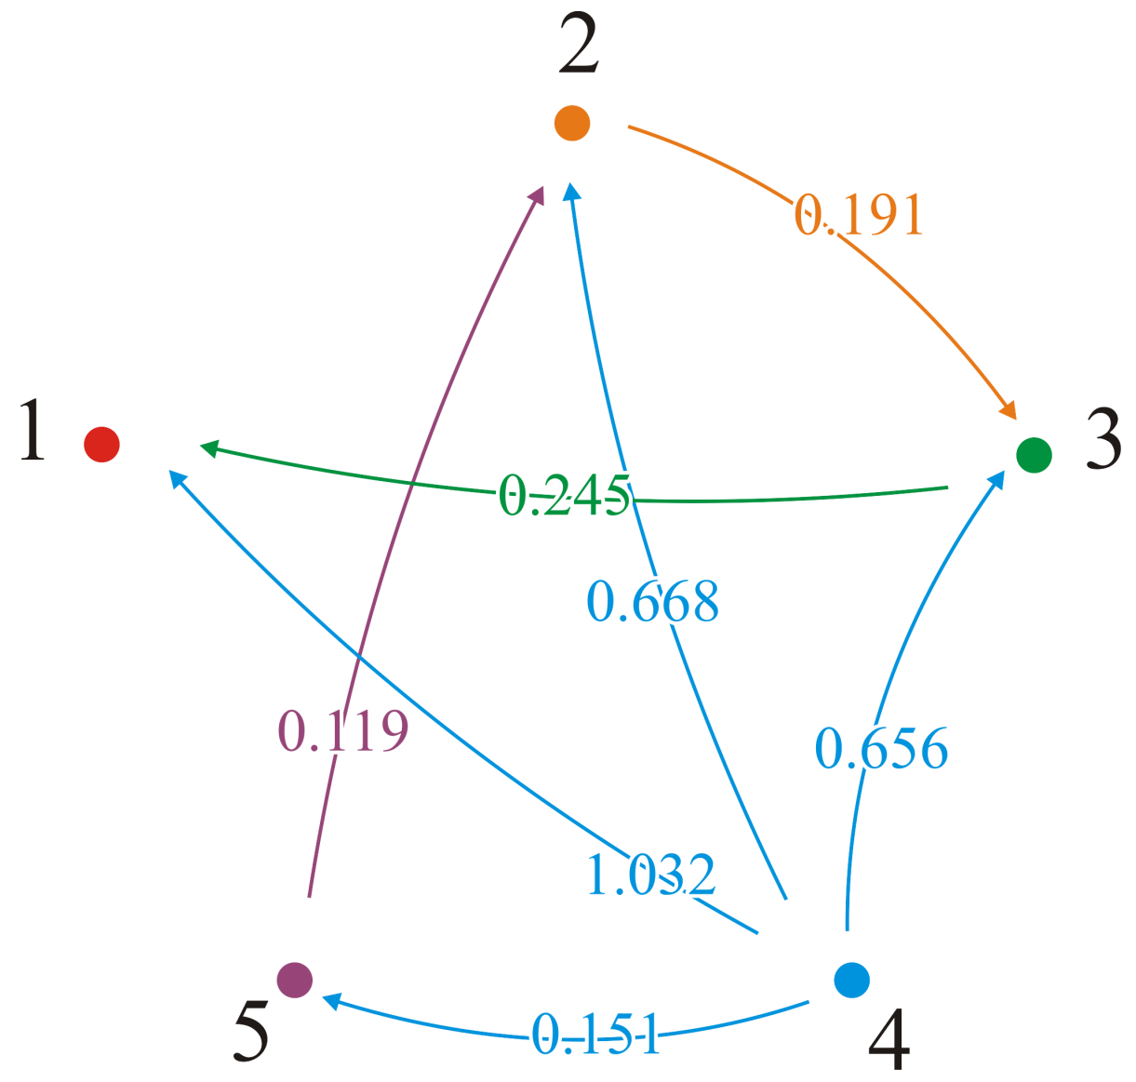
Example
From vertex v₄, p_{4,5} = 5; we go directly to vertex v₅
But p_{4,1} = 5, p_{5,1} = 2, p_{2,1} = 3, p_{3,1} = 1; the shortest path to v₁ is (4, 5, 2, 3, 1)

Slide 53
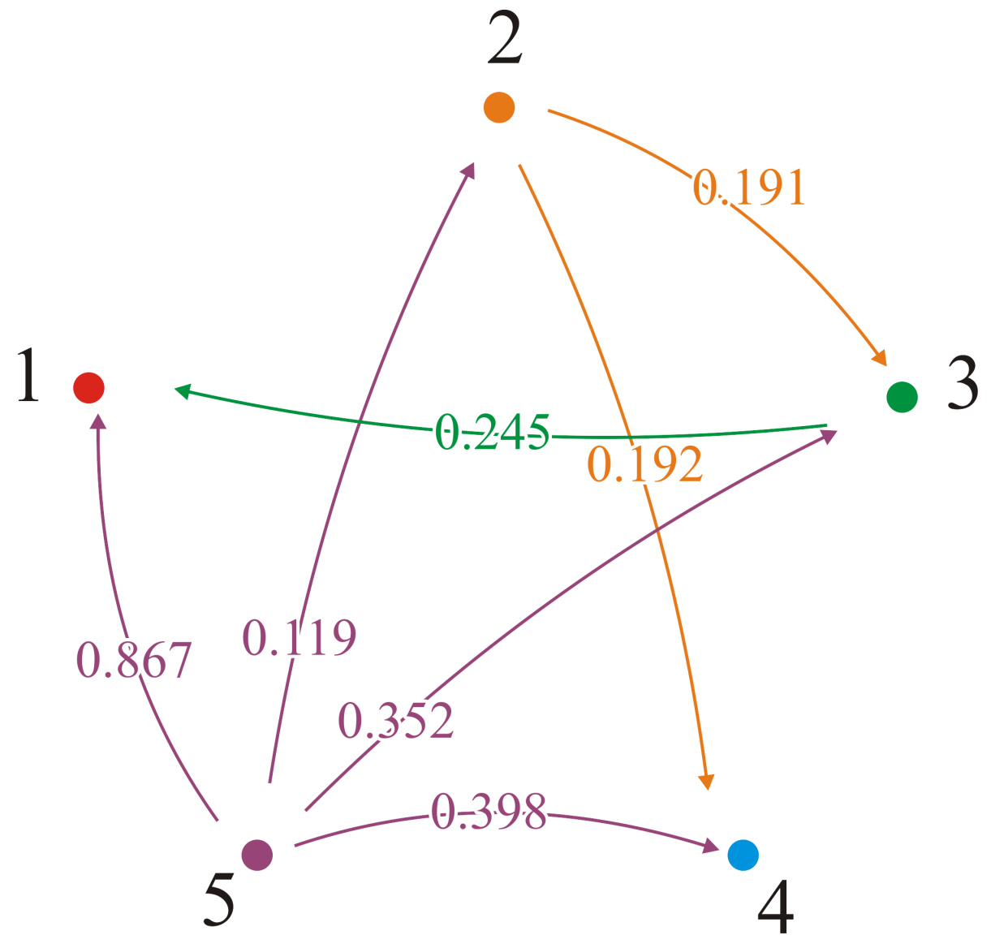
Example
From vertex v₅, p_{5,2} = 2; we go directly to vertex v₂
But p_{5,4} = 2 and p_{2,4} = 4; the shortest path to v₄ is (5, 2, 4)

Slide 54
Comment
CLRS implements it backward, so that a matrix Π stores the predecessors—similar to Dijkstra’s algorithm
Another approach is to store the value k

Slide 55
Which Vertices are Connected?
Finally, what if we only care if a connection exists?
Recall that with Dijkstra’s algorithm, we could find the shortest paths by recording the previous node
In this case, can make the observation that:
A path from v_{i} to v_{j} exists if either:
A path exists through the vertices from v₁ to v_{k–1}, or
A path, through those same nodes, exists from v_{i} to v_{k} and a path exists from v_{k} to v_{j}

Slide 56
Which Vertices are Connected?
The transitive closure is a Boolean graph:
bool tc[num_vertices][num_vertices];
// Initialize the matrix tc: Theta(|V|^2)
// ...
// Run Floyd-Warshall
for ( int k = 0; k < num_vertices; ++k ) {
for ( int i = 0; i < num_vertices; ++i ) {
for ( int j = 0; j < num_vertices; ++j ) {
tc[i][j] = tc[i][j] || (tc[i][k] && tc[k][j]);
}
}
}

Slide 57
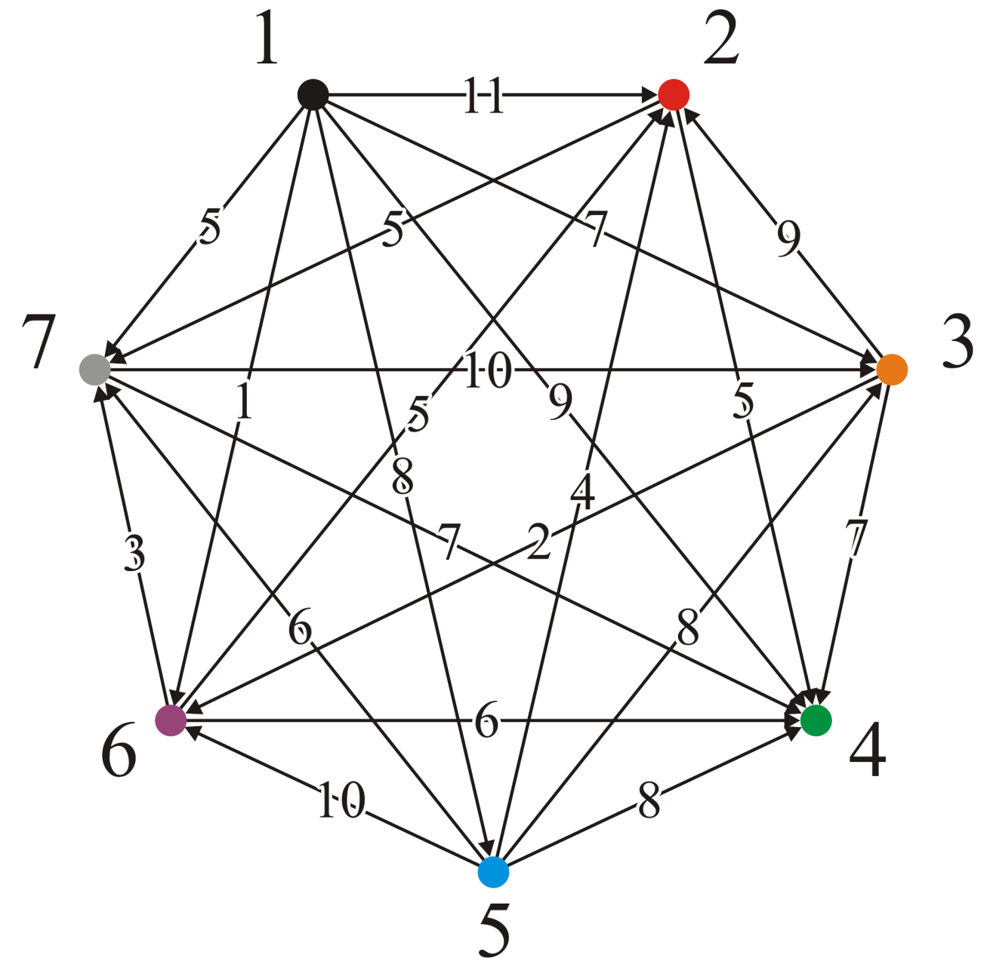
Example
Consider this directed graph
Each pair has only one directed edge
Vertex v₁ is a source and v₄ is a sink
We will apply all three matrices
Shortest distance
Paths
Transitive closure

Slide 58
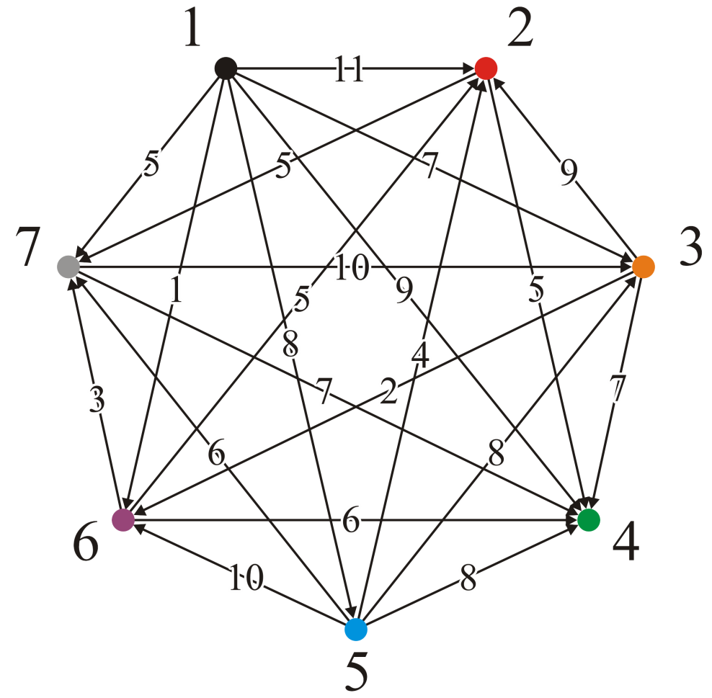
Example
We set up the three initial matrices

Slide 59
Example
At step 1, no path leads to v₁, so no shorter paths could be found passing through v₁

Slide 60
Example
At step 2, we find:
A path (3, 2, 7) of length 14

Slide 61
Example
At step 2, we find:
A path (3, 2, 7) of length 14
We update
d_{3,7} = 14, p_{3,7} = 2 and c_{3,7} = T

Slide 62
Example
At step 3, we find:
A path (7, 3, 2) of length 19
A path (7, 3, 6) of length 12

Slide 63
Example
At step 3, we find:
A path (7, 3, 2) of length 19
A path (7, 3, 6) of length 12
We update
d_{7,2} = 19, p_{7,2} = 3 and c_{7,2} = T
d_{7,6} = 12, p_{7,6} = 3 and c_{7,6} = T

Slide 64
Example
At step 4, there are no paths out of vertex v₄, so we are finished

Slide 65
Example
At step 5, there is one incoming edge from v₁ to v₅, and it doesn’t make any paths out of vertex v₁ any shorter...

Slide 66
Example
At step 6, we find:
A path (1, 6, 2) of length 6
A path (1, 6, 4) of length 7
A path (1, 6, 7) of length 4
A path (3, 6, 2) of length 7
A path (3, 6, 7) of length 5
A path (7, 3, 6, 2) of length 17

Slide 67
Example
At step 6, we find:
A path (1, 6, 2) of length 6
A path (1, 6, 4) of length 7
A path (1, 6, 7) of length 4
A path (3, 6, 2) of length 7
A path (3, 6, 7) of length 5
A path (7, 3, 6, 2) of length 17

Slide 68
Example
At step 7, we find:
A path (2, 7, 3) of length 15
A path (2, 7, 6) of length 17
A path (6, 7, 3) of length 13

Slide 69
Example
Finally, at step 7, we find:
A path (2, 7, 3) of length 15
A path (2, 7, 6) of length 17
A path (6, 7, 3) of length 13

Slide 70
Example
Note that:
From v₁ we can go anywhere
From v₅ we can go anywhere but v₁
We go between any of the vertices in the set {v₂, v₃, v₆, v₇}
We can’t go anywhere from v₄

Slide 71
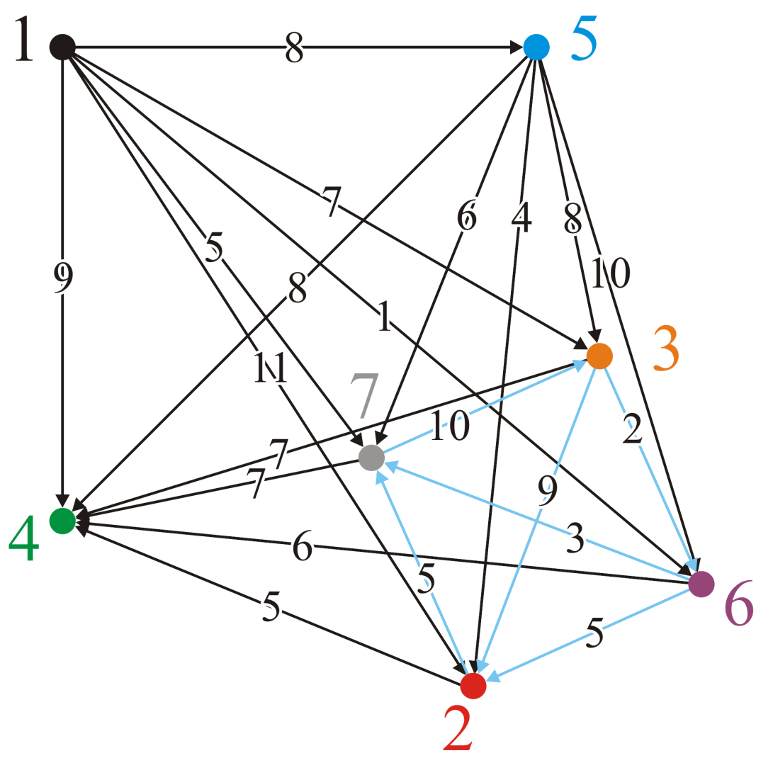
Example
We could reinterpret this graph as follows:
Vertices {v₂, v₃, v₆, v₇} form a strongly connected subgraph
You can get from any one vertex to any other
With the transitive closure graph, it is much faster finding such strongly connected components

Slide 72
Summary
This topic:
The concept of all-pairs shortest paths
The Floyd-Warshall algorithm
Finding the shortest paths
Finding the transitive closure
Notes:
72

Slide 73
References
Cormen, Leiserson, Rivest and Stein, Introduction to Algorithms, The MIT Press, 2001, §25.2, pp.629-35.
Mark A. Weiss, Data Structures and Algorithm Analysis in C++, 3rd Ed., Addison Wesley, 2006, Ch.?, p.?.
Joh Kleinberg and Eva Tardos,
Algorithm Design, Pearson, 2006.
Elliot B. Koffman and Paul A.T. Wolfgang,
Objects, Abstractions, Data Structures and Design using C++, Wiley, 2006.
These slides are provided for the ECE 250 Algorithms and Data Structures course. The material in it reflects Douglas W. Harder’s best judgment in light of the information available to him at the time of preparation. Any reliance on these course slides by any party for any other purpose are the responsibility of such parties. Douglas W. Harder accepts no responsibility for damages, if any, suffered by any party as a result of decisions made or actions based on these course slides for any other purpose than that for which it was intended.

